Slide 1

Getting Started Quickly with DB DevOps
Huxley Kendell
Solutions Engineer
Notes:
Brief from doc:
https://redgate365.sharepoint.com/:w:/s/SalesManagementRoW/EX81XX4LIztHihekC40xAAYBMKrBKFUNQAppoR-uw9ve3Q?e=pS0Kou
45 minutes.
Cover the fundamental features, including the UI, creating a new project, importing/exporting data, and creating basic masking rules.

Slide 2




About me
Huxley Kendell
Solutions Engineer
he/him
https://www.linkedin.com/in/huxleykendell/

Slide 3



















The industry standard
Redgate is the leading provider of software solutions for end-to-end Database DevOps.
More than 200,000 people globally, including 92% of the Fortune 100, trust Redgate to deliver ingeniously simple software.
Notes:
Redgate is the industry standard in Database Devops tooling. Our comparison tech is the industry leading and the bar on which all others are measured.
We have been building tools across the last 20 years that companies all over the world use and depend on. From the largest F100 to many small and medium sized business. No shortage of DBAs and developers have found our tools indispensable in their daily work.

Slide 4
Database DevOps
Notes:
This section is going to focus on 2 main RG

Slide 5
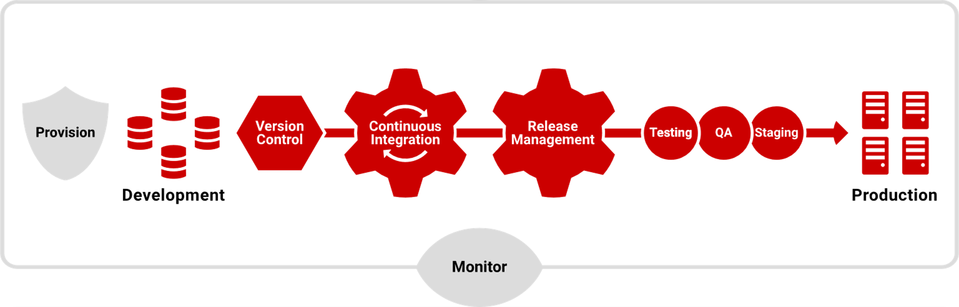
End-to-end Database DevOps
Automate
Accelerate time to market
Deliver value to customers faster through automated database development with continuous integration and continuous delivery.

Slide 6
Continuous delivery of database changes is still challenging
Notes:
How many of the audience can recognise these challenges in their own environments and processes?
This isn’t continuous deployment, which is what many application devs use. With Cdeploy, when code passes tests it’s released to production. We don’t have customers that do this for databases. They keep a human in the loop to review changes because database changes are important and can cause more issues.
As with the other stats, people are looking to implement automated processes to allow humans to review changes, but have them released quickly in a repeatable reliable manner when they are approved.
The big challenges are often complexity. However, the purpose of using Redgate tools is to free up time from tedious work and allow your developers to focus on the techniques needed to overcome the complexities of legacy systems and evolve them to meet your current needs.

Slide 7




Everyone Struggles
Graduate Dev
Graduates / Employees newer to their career
Experienced Employees
Staff who know their job, but not the tooling
Younger / Smaller Companies
With less tooling and experience
Enterprise Companies
With less available time / permissions
Agile Companies
Who need to rapidly evolve
Notes:
A lot of support is available – a real community

Slide 8
Everyone Struggles
Graduate Dev
Graduates / Employees newer to their career
Experienced Employees
Staff who know their job, but not the tooling
Younger / Smaller Companies
With less tooling and experience
Enterprise Companies
With less available time / permissions
Agile Companies
Who need to rapidly evolve
Notes:
A lot of support is available – a real community

Slide 9
Database Automation

Slide 10

Notes:
Popular OSS project RG purchased in 2019. We found this to be a very solid way to deploy code in a repeatable, reliable manner.
We continue to support this, and we have enhanced it in many ways to help our customers ensure the database is not a bottleneck.

Slide 11



Achieve continuous delivery with these 3 Database DevOps practices
Version
control
Continuous integration
Repeatable deployments
Notes:
And this can be achieved by introducing DevOps best practices:
Version control to assign a version to every change that is made to the database. So you know when and who made the change and can shorten the feedback loop
Repeatable deployments: using the same process and approach for every deployments (this includes choosing which development model to follow: State based, migrations based or hybrid. This allows to have a consistent approach that reduces potential risks
Continuous integration to move a committed changed to a pre-defined pipeline and perform various tests increasing the quality of successful candidates and mirror the application process

Slide 12




Automate database deployments across teams and technologies
Standardize DevOps processes & unlock the benefits of database version control
Enable database CI and release automation of database deployments
Left-shift the development experience and remove bottlenecks
Increased compliance and oversight of database deployment processes
Compatibility with existing processes, platforms and toolsets across 50+ database engines
Notes:
Key business benefits

Slide 13
AutoPilot
Notes:
Popular OSS project RG purchased in 2019. We found this to be a very solid way to deploy code in a repeatable, reliable manner.
We continue to support this, and we have enhanced it in many ways to help our customers ensure the database is not a bottleneck.

Slide 14

A tutorial level!
Notes:
A lot of support is available – a real community

Slide 15
Who Struggles
Lack of Time
OnBoarding
With AutoPilot, the only thing they need available is 30 minutes of free time!
Never used CI/CD
Too disruptive
No Experience
Difficult to showcase improvements
Notes:
A lot of support is available – a real community

Slide 16
Demo

Slide 17
Thank you

